Slide 1
__ ____ __ \ \/ / _\/ _\ \ /\ \ \ \ / \_\ \_\ \ /_/\_\__/\__/

Slide 2
Description
The classic code vs data problem
User input (data) is interpreted as code and executed
Never trust user input!!
Types:
Reflected
Stored/Persistent
DOM based

Slide 3
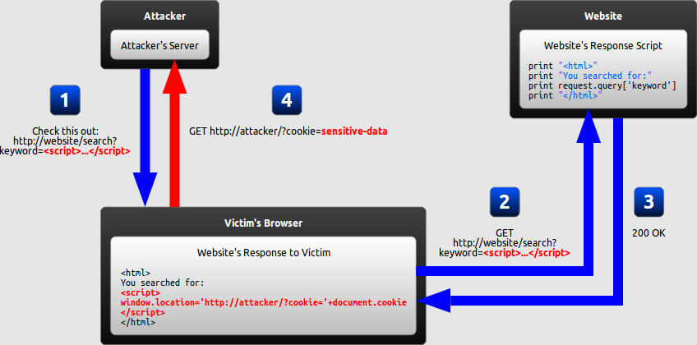
How it works (reflected)

Slide 4
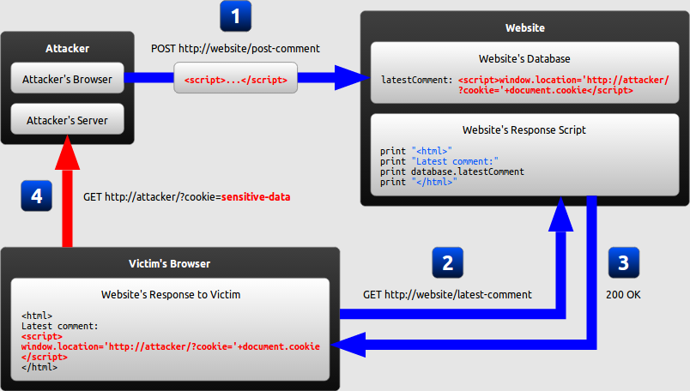
How it works (stored/persistent)

Slide 5
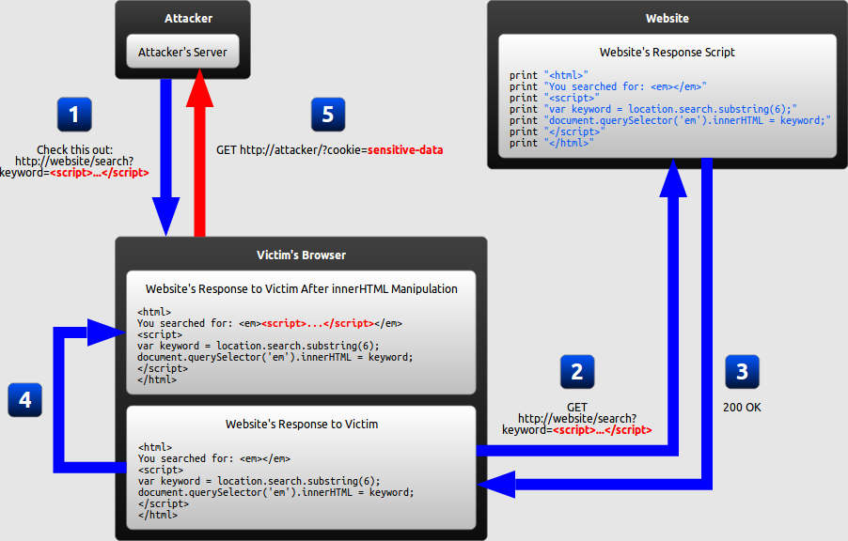
How it works (DOM based)

Slide 6
OWASP code examples

Slide 7
demo

Slide 8
Why it’s so common
Most sites take in a lot of user input
Web 2.0 means web applications
Used to be extra work to sanitize everything
Now it happens by default for newer frameworks
A lot of old code out there
Devs doing weird things
Functionality > security for most

Slide 9
Why it’s bad
4 major attacks
Steal session tokens
Fake login form
Keylogging
XSS framework hooks

Slide 10
How to find it
Place input in all the variables you can
Use something sufficiently unique
See what is reflected back onto the page
See what characters you can get through
Figure out what you can do with the space you have and the characters you can get through
Filter evasion (more on Thursday)

Slide 11
How to mitigate it
HTML Encoding
< becomes &lt;
> becomes &gt;
“ becomes &quote;
‘ becomes %apos;
Things look okay, but will neutralize the attack
Browser mitigations (good job Chrome!)
Validate input: regex [A-Za-z0-9+\s]+
Use mature frameworks and don’t be “clever”

